Slide 1
Session 4 – Pig & Pig Latin

Slide 2
Pre - requisites
Complete Unit 4.0
Faculty Video Lecture
Self Assessment Quiz Complete
Problem Solving Complete

Slide 3
Session Contents
Queries on Unit 4.0
How PIG came into picture
Definition of PIG
Pig Latin
How Yahoo uses it
Different ways to use it
Data Model
Functions and Operators
Word Count in PIG
Max Temp in PIG

Slide 4


How PIG came into picture
Engineers at Yahoo felt the need of a scripting language that enables rapid development as compared to Map Reduce.
So they developed PIG, a lightweight scripting language, meant to be doing all the heavy weight big data tasks.

Slide 5

PIG definition
PIG is a platform for analyzing large data sets is a rapid fashion
A platform that provides a high – level language for expressing data intensive programs. The language is called PIG Latin
It provides the infrastructure to evaluate the above programs. In addition, it also provides a PIG Compiler which converts PIG commands into a sequence of Map Reduce jobs behind the scene.
So overall, PIG platform comprises of three pieces
The language used to express data flows called PIG Latin
A compiler which converts Pig Commands into Map Reduce jobs
And an execution environment to run these jobs.

Slide 6
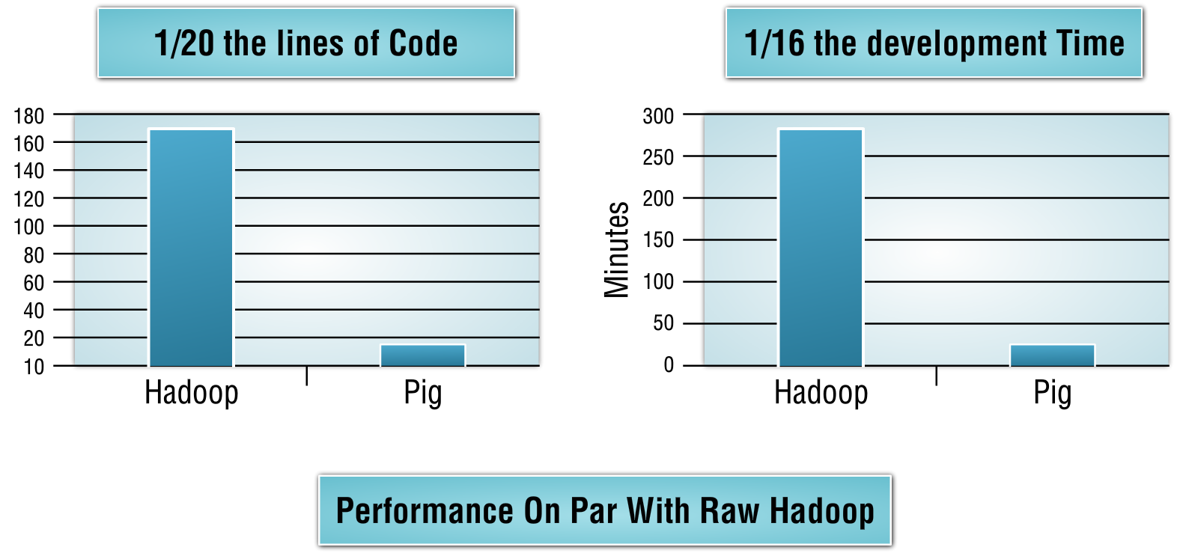
PIG definition (How fast ?)

Slide 7

PIG Latin
PIG latin is a textual language with the following key properties :-
Easy of programming
Optimization Opportunities
Extensibility
It also has a data model of its own

Slide 8
How Yahoo Used PIG
A typical data processing / data warehousing application consists of the following
Data Collection
Data Preparation
Data Presentation
Yahoo uses batch jobs for data collection
PIG is used at the Data Preparation level as an ETL (Extract, Transform and Load) Tool
Hive is used for Data Presentation. Theses Hive jobs take the output from PIG and interact with existing yahoo relational data bases to give output as presentation

Slide 9
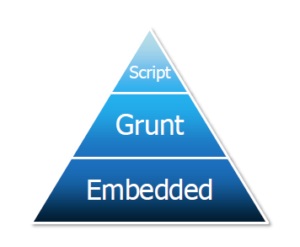
Different ways of using PIG
Pig Script
Grunt Shell
Embedded Code

Slide 10
Pig Data Model
Field (Piece of Data)
E.g. (Any values like 1,2,3,4 or literals)
Tuple (Ordered set of field)
E.g. <1,2>,<3,4>,<5,6,7>
Bag (Collection of Tuples)
E.g. {<1,2>,<3,4>,<5,6,7>}
Data Maps (Key Value pairs where keys are string literals and value could be any data type)
E.g. [‘Manipal’,’Hadoop Course’]

Slide 11
Functions & operators demo

Slide 12

Queries on Unit 3.0

